Slide 1
Session 2.2 Logical Modelling
IN705 Databases 3 - 2018
Notes:
Based on Churcher, chapters 7-9

Slide 2
Purpose
To transform an entity-relationship model into a normalised relational schema
Notes:
A “relational schema” means a set of tables, with all their columns with data types and domains defined, and all primary and foreign keys identified.
So it’s something we can implement in Oracle or Access or SQL Server or FileMaker, using the local dialect of SQL, or the provided GUI tools
Unlike the ERD, it does depend on the DBMS you are using
Don’t worry about the “normalised” part if you don’t remember it, we will get there.
Unlike conceptual modelling, which is artistic voodoo, logical modelling is fairly mechanical, so much easier
However, there are still decisions to be made, and it’s still important to get them right
Failure to do so will lead to a performance hit when the database is implemented. In the worst scenario, some use cases may not be implementable if you get things wrong enough.
Again, since you have seen this before, we will review quickly, then concentrate on the complex issues that you might not have encountered, or which are generally likely to cause problems.

Slide 3
Process
Follow through mechanical conversion steps.
Normalise as required
Notes:
We will go through both of these parts
The first bit is quite deterministic
Normalisation is also very methodical, but does involve a few more decisions
Regardless, it’s still a lot easier than making the conceptual model

Slide 4
Mechanics of Conversion
Entity | Becomes a table
Attribute | Becomes a column Choose data type carefully Identify primary key for each table
1-Many relationship | Give the table at the many end a foreign key to the table at the one end
Many-to-Many relationship | Insert a table between, with two 1-Many relationships
Optionality = 1 | Make the foreign key NOT NULL
Parent/Child | Tricky
Notes:
MAKE HANDOUT OF THIS SLIDE
You have an ERD with entities, relationships with ordinality and cardinality defined, and lists of attributes for each entity
For each element, do as shown
So, for each entity, you write a CREATE TABLE….
Each attribute is a column in the CREATE TABLE. Do we need to go over the SQL data types?
We will look at an example of the Many-to-Many process
We will also look at Parent/Child in detail, in a minute. As mentioned, it is not directly supported, so we have to work around a little

Slide 5
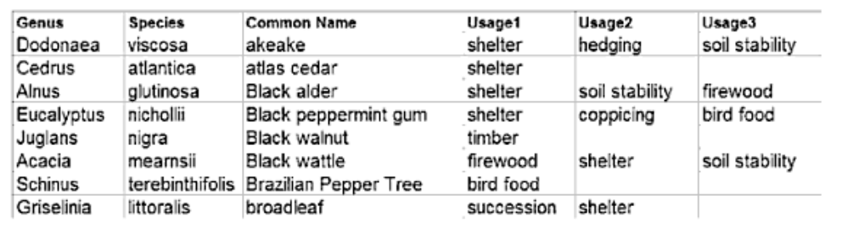
Example
Based on an example from Churcher
Notes:
You are working for a landscape company
They have an Excel spreadsheet like this, with plants with their scientific name, common name, and usages
It’s no longer working for them (for example, it’s a pain to look up all the shelter plants) and they want a real DB.
Let’s take a moment and think about the conceptual model we might produce….
We might just say: “Plant entity, with attributes genus, species, common name and usages”, basically a conversion of the spreadsheet into a database.
At that point we would know we were in trouble. No attribute can be a plural in a relational database
We need to recognise that the usage is itself a relevant concept in the data universe, and should be its own entity.
It will be an entity with a very specific domain – those terms we wish to use to define a usage.
So we start with a rough model like this: Two entities, and (how do we implement that plural?) a many-to-many relationship between them

Slide 6
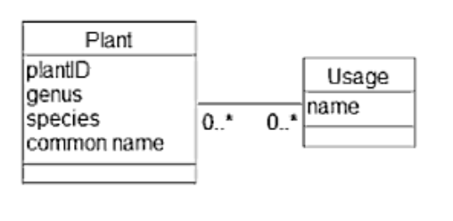
Example
Notes:
We’ll put the attributes in here so we can discuss them, remember that your ERDs don’t have to show the attributes if that makes things too messy
A single plant can have 0 or more uses; a single use can apply to 0 or more plants
Why do we allow 0 uses for a plant? (We might want to enter some new exotic plant into our database before we really knew what it was good for)
This seems like a good start, and we show it to the client.
They then mention that they get all sorts of data entry problems with people entering the wrong genus and species information.
You know nothing about this, so you ask them to elaborate. They explain that a given Genus has many Species (a given Species always belongs to the same Genus) and for plant choice the Genus is an important selector, but that their data entry people often make spelling errors so they can’t successfully search on Genus.
You could address this data integrity problem in the front end, writing code to check that the user’s value is correctly typed (we will look at this situation later), but you can also address it at the database end, using foreign key constraints to make it impossible to enter a record with a misspelled name for Genus.
Any ideas how to do that?
Recognise that Genus is an important logical entity in this problem, just the way Usage is, and make it it’s own class.
This decision brings us to this conceptual model….

Slide 7
Example
Genus
1..1
1..n
Plant
Usage
0..n
0,,n
Genus name
Plant ID
Species Name
Common Name
Usage Name
Notes:
So here’s our little model
Each plant has exactly one Genus; each Genus applies to 1 or more plants (Why not 0 or more?)
Each plant has 0 or more uses; each use applies to 0 or more plants

Slide 8
Example
Genus
Plant
Usage
1..1
1..n
Species Name
Common Name
0..n
0,,n
Genus name
Usage Name
Entity -> Table
Attribute -> Column
1-Many -> Foreign Key
Many-Many -> Linking Table
Optionality 1 -> FK NOT NULL
Notes:
Recall the steps we go through….
Work this out…..
Three tables

Slide 9
Example
Entity -> Table
Genus(…
Plant(…
Usage(…
Notes:
Note that we may get more tables later, as we implement any many-to-many relationships

Slide 10
Example
Attribute -> Column
Choose data type carefully
Identify primary key

Slide 11
Example
Genus
Genus
genusName
String type
Primary Key
char, nchar, varchar or nvarchar?
Genus name
Notes:
Let’s look at our first data type decision.
There are four ways to store a string in SQL: char, nchar, varchar or nvarchar?
Do you remember the difference?
This little choice is our first implementation-level decision. Getting this wrong will hurt your database performance.
You need to know the correct choice to make

Slide 12
Data Type Decision
Strings mostly the same length
Yes
No
char | varchar
nchar | nvarchar
Yes
256 char.set
Is enough
No
Notes:
The difference between the n and not-n versions is size.
The not-n’s use 8 bits of storage, and are thus limited to the small ASCII 256 element character set
The n’s use 16 bits of storage, and allow the 2**16 element unicode character set.
If you don’t need all those fancy characters, why pay 16 bits per letter?
The difference between the var and non-var is also size, but it’s more complicated.
If you use char(10), you get 10 characters of space in every record, regardless of the size of the string (and 10 is the maximum allowed)
If you use varchar(10) you can have up to 10 characters, but the system only allocates space for as many as you actually have. If a lot of your record values are smaller than 10 characters, you will save a lot of space using varchar.
So why would you ever use char? Put another way, what is the advantage of using a fixed –sized field?
Think about what the hardware has to do when you make a query that wants the field *after* your char or varchar.
If the field is a fixed size char, how can you figure out where on disk to look? (A constant equation)
If the field is a variable size varchar, how can you figure out where on disk to look? (You have to know how many characters were used, so you can calculate the memory location)
So, for varchar, you have to save the size of the field somewhere (takes up space) and use it in your computation (increases complexity)
Thus, somewhat counterintuitively, char is often better, unless your data set is highly variable in length, with some really long instances, leading to a lot of wasted empty bits.
The moral here is really a little more than just about nchars though, it is: KNOW YOUR DBMS

Slide 13
Example
Plant
Species Name
Common Name
Plant
speciesName varchar(50)
commonName varchar(50)
What’s the Primary Key?
Add
plantID int IDENTITY
Notes:
So back to these tables….
What’s the critical feature of a Primary Key? => It must be unique for every record in the table. This is a deal breaker
So will species name always be unique? Not necessarily. Different Genus’ can have the same species name
Will common name always be unique? Certainly not. For example, there are two completely different plants both called “geranium”
So there’s no primary key here.
What must we do? We can use a compound (more on that later) or, we can add a field whose sole purpose is to be unique.
We will add an artificial attribute that is just a unique identifier. You know these, they are called IDs
You will recall the IDENTITY qualifier, which is how you make SQL generate these values automatically.
Always use your system’s autonumbering facility for these constructed ID fields.
Sometimes, we have a choice of generating an ID or using a combination of other fields for the PK, we will discuss the adv/disadv of each approach in a minute

Slide 14
Example
Usage
Usage Name
Usage
usageName varchar(30)
Primary Key
Notes:
Nothing complex here….yet….

Slide 15
Example
Genus(genusName…
Plant(plantID, speciesName, commonName…
Usage(usageName…
Notes:
And you could write the CREATE TABLE statements to make these if you wanted to
But, there are likely to be more fields added as we implement the relationships

Slide 16
Example
Genus
Plant
1..1
1..n
Species Name
Common Name
Genus name
1-Many -> Foreign Key
Plant(plantID, speciesName, commonName, genusName)
CONSTRAINT FK_plant_genus FOREIGN KEY(genusName)
REFERENCES Genus(genusName)
Remember to make the foreign key NOT NULL
Notes:
We’re looking at this part of the ERD for this step….
The next step is to convert 1-Many relationships to foreign keys
We have 1..n: Each Plant has one Genus; each Genus has many plants
We put the foreign key in the one there can be “many” of, in this case, plant
Make it the same data type as genusName is in tblGenus
When you CREATE TABLE, you will add the foreign key constraint.
The system will enforce the referential integrity
Nobody will be able to enter a new Plant record with an illegal genus name

Slide 17
Example
Plant
Usage
Species Name
Common Name
0..n
0,,n
Usage Name
Many-Many -> Linking Table
Plant
Usage
1..1
0..n
Plant_Usage
0..n
1..1
Species Name
Common Name
Usage Name
Notes:
Now we concentrate on this part…
We have one many-to-many relationship
Plants can have many usages; Usages can apply to many plants
To implement this, we create a linking table between them, with two 1..n relationships
It is helpful to name these tables something that makes it clear what job they are doing
Read as follows:
Each plant can have 0 or more linkages; each linkage refers to exactly one plant
Each usage can have 0 or more linkages; each linkage refers to exactly one usage
A record in the table linking Plant(p) and Usage(u) means that Plant(p) is associated with Usage(u)
When you do a query, you might, for example, select all the records for Plant(p) in Plant_Usage, and then list all the Usage values in that record set.

Slide 18
Example
Plant
Usage
1..1
0..n
Plant_Usage
0..n
1..1
Species Name
Common Name
Usage Name
PlantUsage(plantID, usageName)
What is the Primary Key?
Natural primary key
Notes:
This is a table, it must have a primary key, which must be unique
plantID? No, of course not. That’s 1 to many
usageName? No, of course not. That’s 1 to many
Need an IDENTITY field?
Well, you could, but there is a better alternative
Note that no record in this table will ever need to have the same plantID and usageName. That wouldn’t make sense. Those are the only fields in the table, so putting them in twice wouldn’t add any new information to the database.
Thus, while neither of those fields alone will be unique, their combination will be
We will choose this combination as our primary key
This is called a “natural primary key”
When they are available, natural primary keys are good things. Can you think why?
If you declare PK(PlantID,usageName) the system won’t let anyone enter a duplicate record on those fields by mistake, which we have just established is something we want to avoid. No need to clean the data if they can’t get dirty.

Slide 19
Example
Genus
genusName
Plant
plantID
speciesName
PlantUsage
commonName
plantID
genusName
usageName
Usage
usageName
Notes:
So this is our final logical model

Slide 20
Dealing with Inheritance
The relational model, and by extension, relational DBMSs do not support inheritance.
Notes:
So you have to fake it

Slide 21
Dealing with Inheritance
Options:
Flatten:
Implement only the children
Add all attributes from the parent to each child
Roll up:
Implement only the parent.
Add a type attribute to distinguish child classes
Make non-common attributes optional
Approximate:
Implement both parent and child tables
Build a 1-1 relationship between each child and its parent
Notes:
Which of these is best depends on your model.
For example, the number of different child classes, the number of common and non-common attributes, etc.
You may have to try various ways and test which is most efficient and best insures data quality.
Speaking of which…

Slide 22
Data Quality
Data integrity:
All data values are from the appropriate domain.
Data uniqueness
All values that represent the same property of an instance must have the same value
Referential integrity:
For any value of a foreign key in a dependent table, a record with that value as primary key must exist in the referenced table.
Notes:
With hundreds of tables and thousands of records, the risk of errors is very high.
There are three technical ways that we talk about error-free database contents:
Integrity
An attribute’s “domain” is the set of legal values it may hold. If, for example, we are storing street names in Dunedin, the variable data type will be some sort of text option (char, varchar, whatever) but the domain will be only those strings that correspond to actual streets in Dunedin.
Typos on data entry are the most common cause of domain violations
Uniqueness:
You don’t want to have somebody’s address as one value in one table and another value in another table
Ref int:
If your Player records holds Team 17 as a foreign key, there needs to be a Team 17
If we build our tables correctly, the DBMS will enforce data quality so that errors cannot occur. Problems will be resolved before the data ever leaves the server. This is the safest practice.

Slide 23
Data Quality
Violations can be caused by:
Data entry error
Update Anomalies

Slide 24
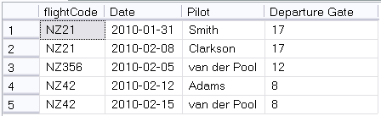
Update Anomalies
A situation where changing a record in the database (via insert, update or delete) causes an inconsistency with other records.
UPDATE Flights
SET gate = 71 WHERE pilot = ‘Clarkson’
Notes:
Look at this table.
It records the pilot of Air New Zealand filghts. Each flight always leaves from the same gate, but can have a different pilot in each instance
What is the primary key?
Not Flight code, that repeats
Not date, there could be two flights on the same day
Assuming that each flight goes only once a day (which is how it works), a good primary key is (flightCode, Date)
A given flight leaves each day from the same gate, as shown. Our data have integrity.
So now this update happens. This is perfectly legal. Gate is not part of the primary key, so the system will execute the update.
The gate is wrong, and we can’t tell which is correct 17 or 71
Anything about the constraints of the database that would prevent this? No.
This is an update anomaly. One of several types that can occur.
Such things can only happen when there are flaws in the design of your tables. Can you see the flaw here?
Perhaps you can, perhaps you can’t. But you don’t want to be in situations where you’re having to try to intuitively guess your table into shape. We’re going to look now at a process which, when followed, will guarantee (almost) that your tables can’t get into a bad state.

Slide 25
Normal Forms
Data quality violations are possible because of flaws in the table design.
The specific requirements for a table design that is not at risk have been determined.
They are called “normal forms”.

Slide 26
Normal Forms
There are five normal forms
1st, 2nd, 3rd (& Boyce-Codd), 4th & 5th
They are
Increasingly safe
Increasingly complicated to implement
Your databases should always be in at least” 3rd normal form.
If your tables are in the appropriate normal form, update anomalies and data entry errors cannot occur.
Notes:
Really 6, but two of them are just variations
If your database is mission critical, so that errors would be life and death, and you can’t stand putting any checking into the GUI, you can consider 4th and 5th Normal Form. Look it up if interested.

Slide 27
Normalisation
The process of putting your tables into the correct normal form is called “normalisation”.
Each normal form addresses a particular structural flaw
There is a two-step process for each normal form:
Detect the flaw
Fix the flaw
After you have constructed your logical model, you should work carefully through normalisation
Notes:
Each form has its own particular problem that you look for
There is also a detailed rule for fixing the flaw if you find it

Slide 28
Example
BIT Staff
BITStaff
staffName
staffOffice
staffEmail
staffCourse1
staffCourse2
staffCourse3
staffCourse4
Notes:
Lesley has this big spreadsheet for keeping track of staff, but it’s getting out of hand, so we make this nice little one-table database that holds all the information in her spreadsheet.

Slide 29
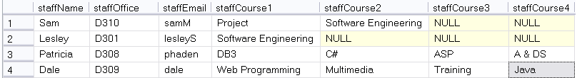
Example
Caution!
No attributes with multiple values (even if they’re pretending to be separate attributes)
Notes:
So here’s our little table.
There are a couple of issues here, like the Primary Key staffName might not be unique, and we’d have to enforce consistency on the names of the papers and so on, but let’s just concentrate on the table structure right now.
See any problems?
What query would you write if you wanted all the Software Engineering staff? You can see that for Sam it’s attribute course2 and for Lesley it’s course 1. To be sure, you’d have to make a big OR, which is messy.
But there’s worse than that. We need to add Dave to the database, but Dave teaches 5 papers this year. Oops.
These are both symptoms of the fact that staffCourse1 to 4 aren’t really four different attributes, they are one attribute (courses you teach) that has multiple values.

Slide 30
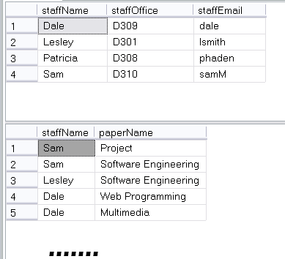
Example
Notes:
We’re seeing just a portion of the papers table here….
So now, how do we find all the SE staff? (Query Papers)
And can we add Dave? (Sure, just add 5 records to Papers)
Congratulations. You’ve put your table into First Normal Form

Slide 31
Example
To repair this problem
Remove the columns that represent the multiple-valued attribute
Give them their own table
Make each value in those columns a row in the new table
For each row add a foreign key that refers back to the record in the original table by its primary key

Slide 32
Example
BITStaff
 | staffName
 | staffOffice
 | staffEmail
Papers
 | staffName
 | paperName

Slide 33
First Normal Form
A table is in First Normal Form if
It has no multiple-valued attributes
There is no ordering to the columns
There is no ordering to the rows
There are no duplicate rows
Notes:
You will often see “multiple-valued attributes” called “repeating groups”. Same things
Technically, there are actually a few more rules about First Normal Form because it is really simply the base definition of what a relational table looks like
These other rules are rules, but nobody ever gets them wrong, so we don’t worry about “how to fix”
Note that the “no ordering to the rows” thing doesn’t mean you can’t sort it. It just means that it’s the same table, regardless of sort order. You don’t lose any data if the sort order changes.

Slide 34
First Normal Form
Flaw:
A table is not in 1st Normal Form if it is keeping multiple values for an attribute.
Fix:
Remove the multivalued information from the table.
Create a new table with that information, and the primary key of the original table.
Notes:
Most likely, with a little experience in data modelling, you won’t ever try to create a table that isn’t in 1st Normal Form.
But you know what to look for, and what to do.

Slide 35
Example
Enrollment
Student
studentID
studentID
instrument
lastName
grade
firstName
fee
Notes:
The Saturday Morning Music Classes in Dunedin have hundreds of students, both child and adult.
They teach all different instruments at all different grades
The fee structure is based on instruments (recorder is cheaper than trombone because of the teacher/student ratio required)
Here’s the database they use to record their enrolment information.
You can see they have separate fields for lastName and firstName. The studentID is an IDENTITY field so must be unique.
It therefore correctly serves as a foreign key in Enrollment
Here are some data values in

Slide 36
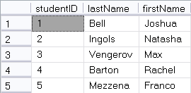
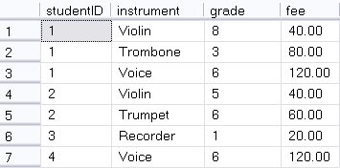
Example
UPDATE Enrollment
SET fee = 50
WHERE studentID = 1 and instrument = 'Violin'
Notes:
This structure looks pretty good.
Think about the questions we might want to ask, and make sure we can ask them
Can you list all the violin players together?
Can you tell how much money Joshua Bell owes? If you knew his ID number? If you didn’t?
So, where is there a problem with this database?
Look at this query
Is it legal? (i.e. does it violate any constraints, here specifically the foreign key or record uniqueness?)
So the system will allow it. It is a perfectly ok query.
But what is the result?
Joshua will pay 50.00 for his violin lesson and Natasha will pay 40 for hers. Looking at the database, can anyone tell which was the error and which is correct?
This is an update anomaly (modification) causing a data uniqueness error

Slide 37
Example
DELETE Enrollment
WHERE instrument = ‘Trombone’
AND studentID = 1
Notes:
How about this one?
Legal?
Consequence? You no longer have any record of the fee for Trombone. Joshua was the only student taking it, and because he dropped it, you lost that piece of information.
This is an update anomaly (deletion)
So this particular table is at risk of both modification and deletion anomalies (insertion too, if there’s a data entry error on fee….)
Can you see, intuitively, what the problem is?
To understand formally what this error is (which will allow us to establish an orderly process for fixing it) we need to look carefully at what’s happening with the primary ketys….

Slide 38
Example
Student(studentID, lastName, firstName)
Enrollment(studentID, instrument, grade, fee)
What is the primary key of Enrollment?
Notes:
Recall that the primary key must be unique for every record, guaranteed
studentID? No, the same student can take multiple instruments
Insturment? No, there are lots of duplicates?
And obviously not grade and fee, no uniqueness there.
If no single key can be primary, look to combinations of keys.
(Assuming that we aren’t keeping any historical record of grade) What combination will be unique?
studentID and instrument. There would be no meaning to listing the same student/instrument combination twice. This makes a good primary key

Slide 39
Example
Student(studentID, lastName, firstName)
Enrollment(studentID, instrument, grade, fee)
What is the primary key of Enrollment?
For all the non-primary fields, what fields determine them?
Grade is determined by studentID and instrument
Fee is determined by only instrument
Notes:
Let’s think now about what a primary key is supposed to tell us.
The primary key is the unique identifier of a record. So technically, the primary key of a record should determine all the other values. Meaning, if you know the value of the primary key, you know the value of all the other fields.
E.G. your student ID number determines your name and address, and so on. My name determines my office. The paper and stream determines the classroom. Your address determines your postcode, etc.
Looking back at our table, for each of the non-primary keys, what fields determine them. That is, what fields would you have to know to be able to tell their value
Grade <- studentID and instrument. You can’t tell the grade unless you know both the student and the instrument
Fee is determined by only instrument. You don’t have to know the student to know the fee. It is only based on the instrument, and that is the problem

Slide 40
Definition
Functional Dependence
If A and B are two fields in a relation and A uniquely determines B
B is functionally dependent on A
A → B
In our example
(studentID,instrument) -> grade
Instrument -> fee

Slide 41
Caution!
You should never have a table where
The primary key is composite, AND
Any field is functionally dependent on only some of the fields making up the primary key
Such a table will be at risk of update anomalies.
Uniqueness of the primary key is not enough to guarantee correct values for all the other fields.
Notes:
This is exactly the problem in our table.
Our primary key is (studentID, instrument) but the fee field is only functionally dependent on instrument.

Slide 42
To Fix This Problem
Pull the partially dependent columns out into their own table.
Make the part of the primary key they depend on their new primary key.

Slide 43
To Fix This Problem
Student
Instrument
studentID
instrument
lastName
fee
firstName
Enrollment *
studentID
instrument
grade
Notes:
Now.
Are all field in Student FD on all elements of their PK?
Instrument?
Enrollment?
Congratulations, you’ve got second normal form

Slide 44
Second Normal Form
A table is in 2NF iff:
It is in 1NF
All non-key fields are functionally dependent on all parts of their primary key

Slide 45
Second Normal Form
Flaw:
Some non-key column is functionally dependent on only a subset of the fields which comprise the primary key
Fix:
Remove the non-key fields that are not dependent on the whole primary key
Make a new table with all these fields and the part of the primary key they depend on as the new primary key

Slide 46
Question
If a table is in 1NF and uses an auto-incrementing IDENTITY variable as a primary key, must it also be in 2NF?
Notes:
Yes. If the primary key is only one field, nobody can be FD on part of it.
Let’s look now at those update anomalies we had before

Slide 47
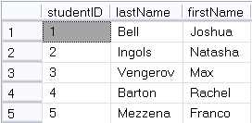
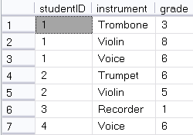
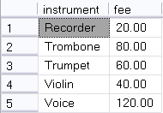
2NF
Notes:
Can you still answer all the questions you want to know?
All the violins? Yes.
How must Max owes? (A 3-table join now)
Is it now possible for Joshua and Natasha to be charged a different amount for Violin lessons? No.
If Joshua decides to drop the Trombone, do we still know what the fee for Trombone is? Yes.

Slide 48
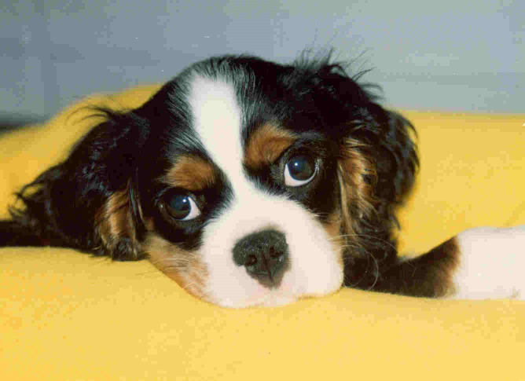
Example

Slide 49
Example
CavEvent
eventID
eventDate
eventLocation
eventJudge
dogName
dogOwner
Notes:
You’re keeping track of winning Cavalier King Charles Spaniels in dog shows

Slide 50
Example
EventID | Day | Location | Judge | Dog | Owner
1 | 2/10/2009 | Westminster | Beth Sweigart | Ch Timsar Mister Moonlighter | Cindy Huggins
2 | 30/09/2009 | Inglison | Robert Waddington | Ch Nottus Hooray Henry | James Jackson
3 | 8/11/2009 | Higham | Michale Forte | Ch Cinderlace Cromwell | Albert Vella
4 | 12/12/2009 | Los Angeles | Beth Sweigart | CH Pinecrest Rock The Boat | Margaret duBois
5 | 14/06/2009 | Bristol | Vladimir Lizorov | Ch Timsar Mister Moonlighter | Cindy Huggins
6 | 20/02/2009 | San Diego | Paula Mitchell | CH Pinecrest Rock The Boat | Margaret duBois
7 | 11/01/2009 | Boston | Kevin Sherman | CH Anberran Ginger Truffle | Evan Mondrian
8 | 9/03/2009 | Edinbirgh | Vladimir Lizorov | Ch Timsar Mister Moonlighter | Cindy Huggins
Notes:
No repeating values, so this is in 1NF
A non-composite primary key, so it’s in 2NF
So, no problems?
See the trouble? What happens when Cindy Higgins sells Timsar Mister Moonlighter?
You would have to change all the occurrences, which, like code duplication in programming, is just asking for data inconsistencies to be introduced
And, if you have a big database with all the dozens of shows each dog has won? The mess is just worst.
So based on your understanding of the whole database thing now, what would you suggest?

Slide 51
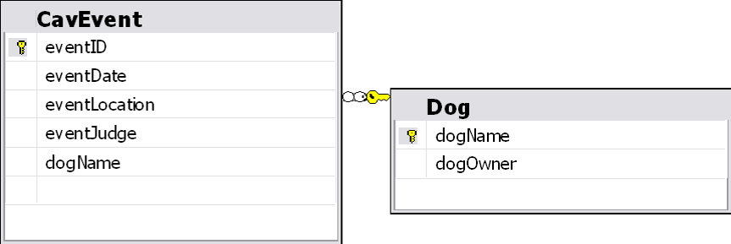
Example
Notes:
Pull out the dogOwner column into its own table, and make dogName the FK
What looked wrong? The repetition of the owner value?
It’s good if you can tell by looking what the problem is, but in a 100 table database, you don’t want to be counting on that.
Let’s look at what’s going on here….
The problem can be seen by looking at the functional dependencies.

Slide 52
Example
EventID Primary Key
Day Event ID
Location Event ID
Judge Event ID
Dog Event ID
Owner Dog
Notes:
Who depends on what? That is, what value would you have to know to be able to figure out each column
And there is your problem.
Note that you could tell who the Owner is from the Event ID, but you could also tell who the Owner is without it.
If you know the Dog, you know the Owner, regardless of what day or show or anything else
Therefore Dog->Owner, and if Dog changes you’re in trouble

Slide 53
Example
Dog -> Owner
Dog is not a primary key
Therefore, you can have repeated instances of Dog in the table
In which case you will have repeated instances of (Dog, Owner) in the table
If (Dog, Owner) changes, you must update all repetitions

Slide 54
Caution!
If any column is functionally dependent on a non-primary key your table is at risk of update anomalies.
Notes:
Get rid of them, and you’ve got 3rd normal form

Slide 55
Third Normal Form
Flaw:
Some column is functionally dependent on a non-key column.
Fix:
Pull the dependent column out into its own table. The column on which it depends becomes it primary key.

Slide 56
Make Robust Tables
1NF:
Remove repeating values
2NF:
Remove any functional dependencies on partial primary keys
3NF:
Remove any functional dependencies on non-primary keys
Notes:
Usually your tables will start out in 1NF. So it just becomes a process of looking at the FD of every column in every table.
With practice, you’ll be able to see these problems well.

Slide 57
Make Robust Tables
“Your data should depend on the key (1NF), the whole key (2NF) and nothing but the key (3NF)”

Slide 58
Avoiding Normal Form Violations
It’s good to be able to spot NF violations and fix them.
It’s better for them never to occur in your logical model at all
Many can be avoided through careful conceptual modelling
Notes:
In fact, many of the problems in the examples we saw today would never have come up in any model you would have made.
You would probably just automatically have made a tblDog with all the dog dependent information in it

Slide 59
Avoiding Normal Form Violations
Describe, in one word, the common feature of all the flaws….
….redundancy
Each entity in your conceptual model should describe one thing
Each piece of information in your conceptual model should be in one place
Notes:
All the bad things happened because data was repeated in the table (or some flavour of that)
What is this like in OO? (High cohesion, low coupling)

Slide 60
Exercise
Notes:
Handout
ERD conversion task
Normalisation task (theatres)
This is a checkpoint

